Slide 1
Neio: TeX for the 21st century
Titouan Vervack
Promotor: Professor Marko van Dooren

Slide 2
What is it?
Markup language
Inspired by TeX and markdown

Slide 3
What’s wrong with Markdown
Not extensible
Too simple (no customisation)
No programming model

Slide 4
What’s wrong with TeX
Steep initial learning curve
Allows redefenition of commands
Overly complex
Not statically typed

Slide 5
What’s wrong with Word
Corruptable fileformat
Not platform independent
Overkill for very simple documents
Not well suited for very complex documents

Slide 6
Goals
Easy to get started with
As powerful as TeX
As simple as markdown
Static typesystem

Slide 7
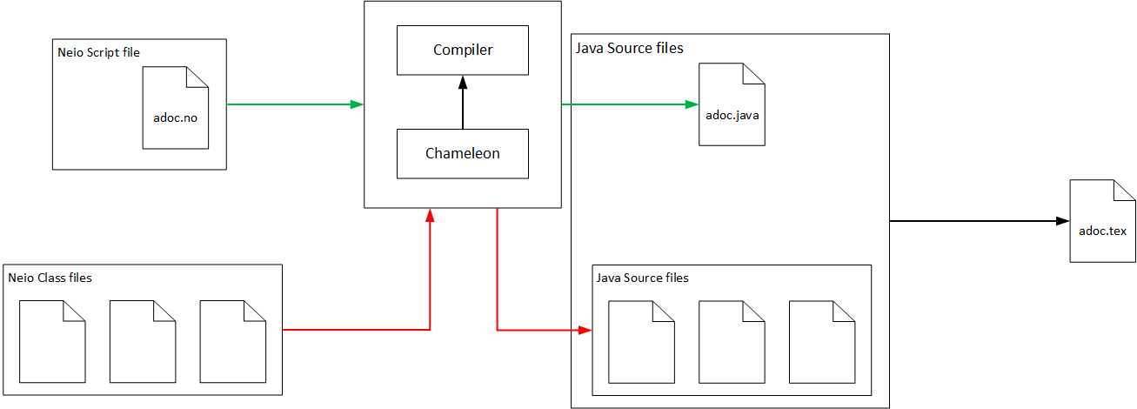
Compile flow

Slide 8
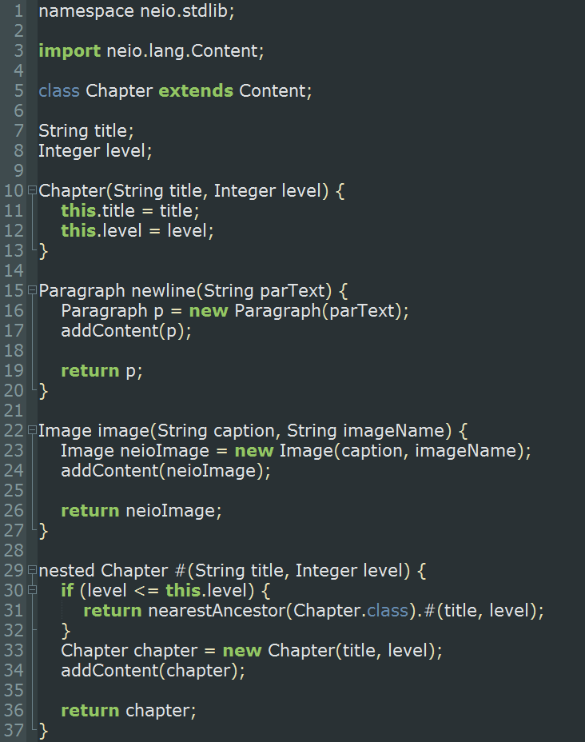
Neio class files
Javalike syntax
Adoptability
Easy translation

Slide 9
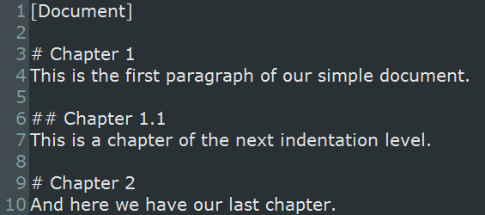
Neio script files
Markdownlike syntax
Adoptability
Easy to read/write
Non-corruptable

Slide 10
Why output in java?
Chameleon can output Java
Java is statically typed
Java is platform independent
Java semantic ≈ Neio semantic

Slide 11
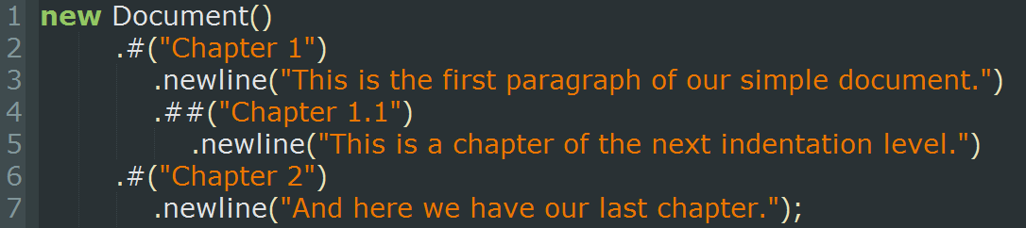
Building a document
Start out with documentclass
Everything is a methodcall

Slide 12
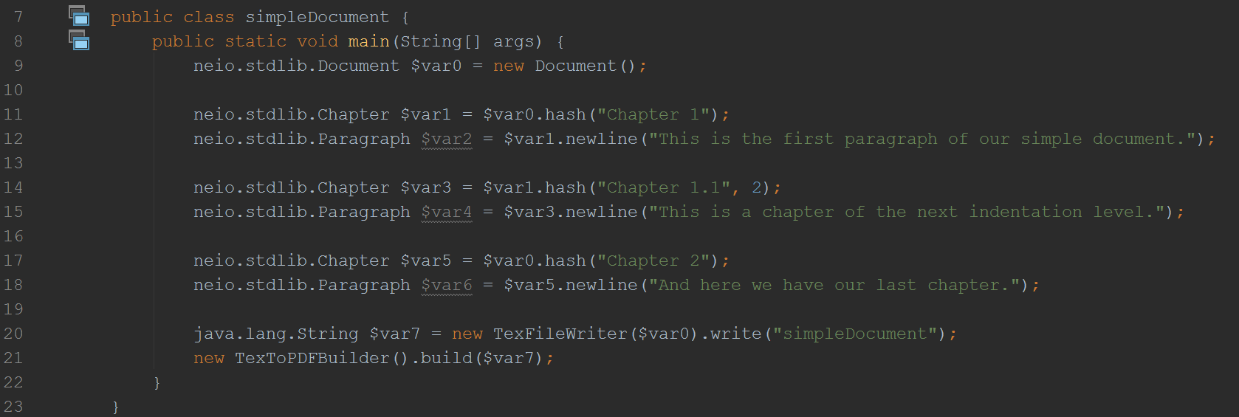
Building a document

Slide 13
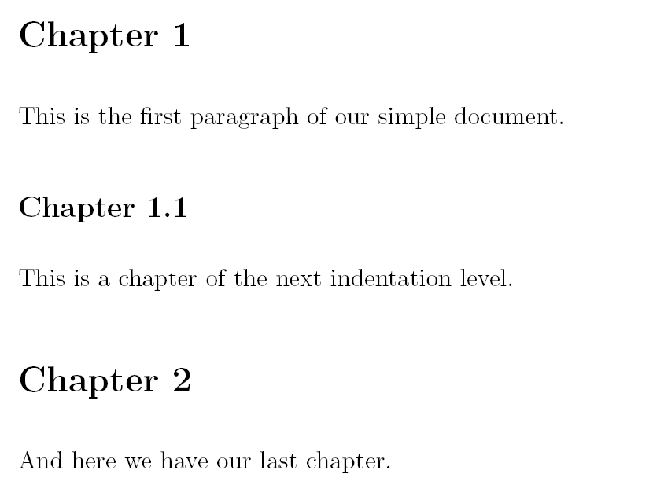
Building a document: result

Slide 14
Nested methods
Allow for nesting of method
nested type f(arg, Integer)

Slide 15
Context types
Document
Chapter
Paragraph
Chapter
Paragraph
Chapter
Paragraph

Slide 16
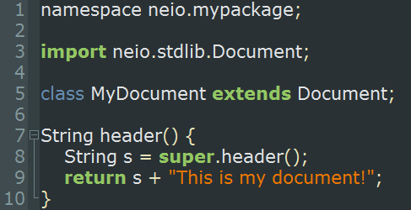
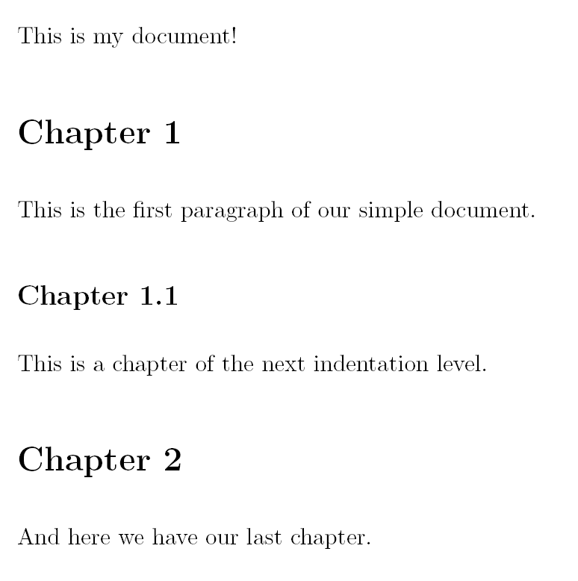
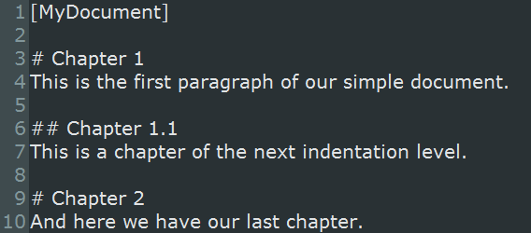
Customisability: inheritance

Slide 17
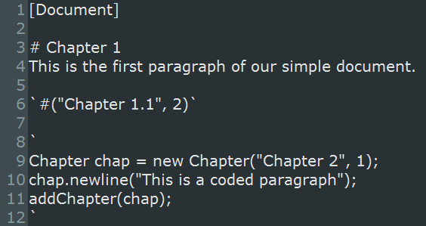
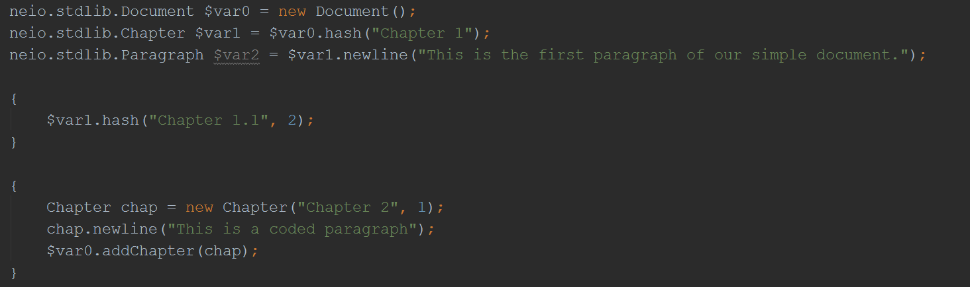
Customisability: executing code

Slide 18
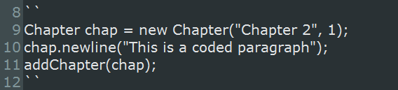
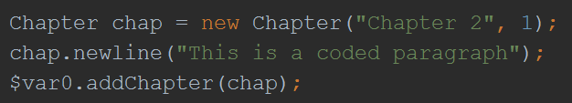
Customisability: executing code

Slide 19
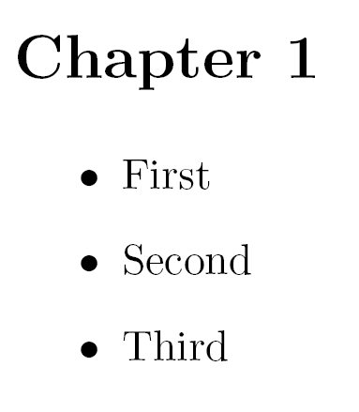
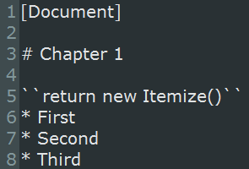
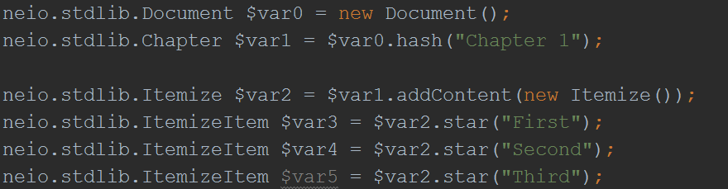
Add content through code

Slide 20
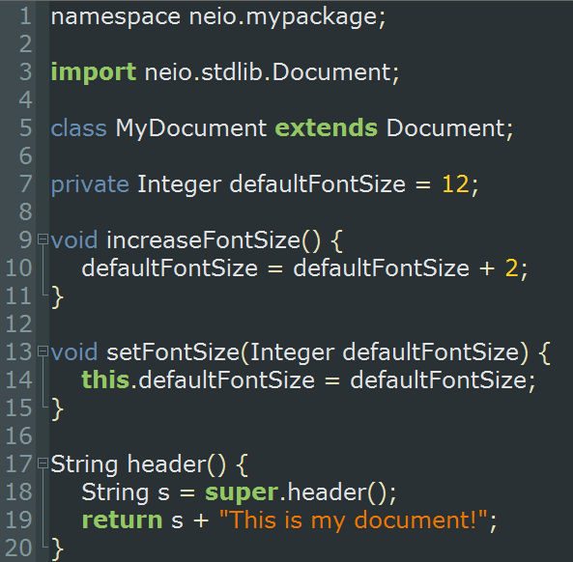
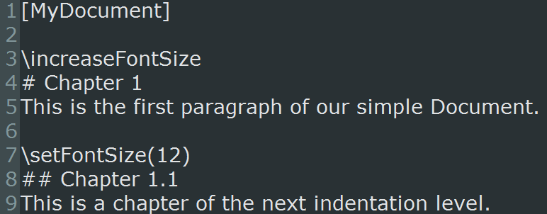
Customisability: custom commands

Slide 21
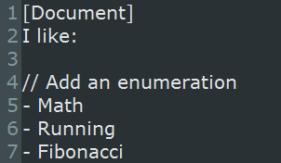
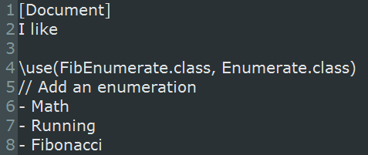
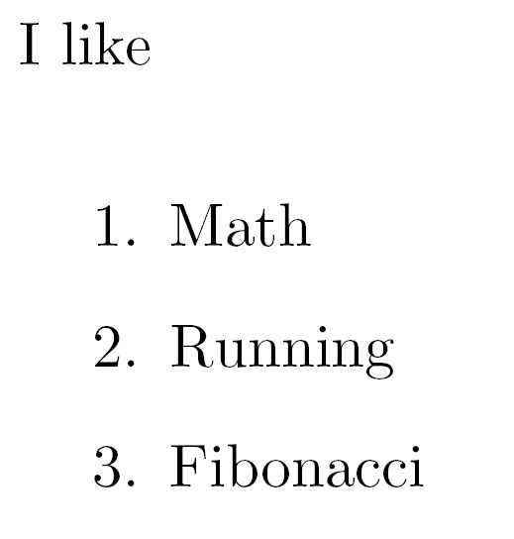
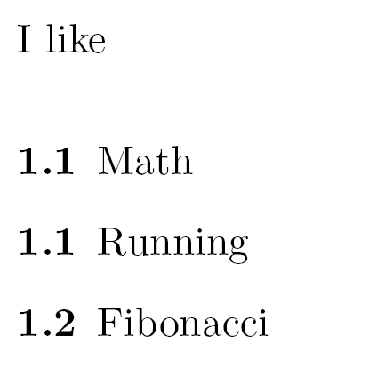
Customisability: use

Slide 22
Future work before hand in
Inclusions
Slideshows
Surround methodes
Further controles on static typing
Create more documentclassses (article, letter, book,…)
*bold text*
bold text

Slide 23
Future work
Compiler optimizations
Aliases for methods (e.g. alias star for *)
Automatic double latex compile detection
Native output to languages other than latex
Further implementation of commonly used latex packages

